Slide 1
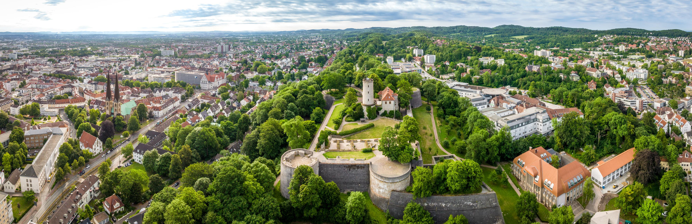

EOOLT 2026: 10th International Workshop on Equation-Based Object-Oriented Modeling Languages and Tools
Copyright Teutoburger Wald Tourismus / D. Ketz
June 2026, Bielefeld, Germany
General Chair:
Bernhard Bachmann
Hochschule Bielefeld,
University of Applied
Sciences and Arts
Program Chair:
Benoît Caillaud
INRIA Rennes, France
https://eoolt.org/
All topics related to equation-based modeling: from language design, semantics and static analysis to code generation, simulation and modeling methodologies.

